Slide 1

Vezbe 2

Slide 2
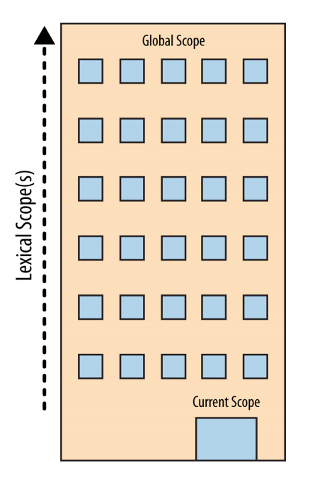

Slide 3
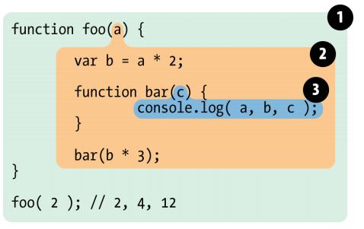

Slide 4
Cheating Lexical scope
function foo(str, a) {
eval(str);
console.log(a,b);
}
var b = 2;
foo("var b = 3;", 1);

Slide 5
Function scope
function foo() {
for (var i = 0; i < 10; i++) {
bar(i * 2);
}
function bar(a) {
i = 3;
console.log(a+i);
}
}
foo();

Slide 6
Function scope?
try {
undefined();
} catch (err) {
console.log(err);
}
console.log(err);

Slide 7
Function scope?
(function () {
try {
throw new Error();
} catch (x) {
var x = 1, y = 2;
console.log(x);
}
console.log(x);
console.log(y);
})();

Slide 8
Hoisting
var x = 21;
var pera = function () {
console.log(x);
var x = 20;
};
pera();

Slide 9
Closure
function makeFunc() {
var name = 'Mozilla';
function displayName() {
alert(name);
}
return displayName;
}
var myFunc = makeFunc();
myFunc();

Slide 10
Function invoking
var hero = {
_name: 'John Doe',
getSecretIdentity: function (){
return this._name;
}
};
var stoleSecretIdentity = hero.getSecretIdentity;
console.log(stoleSecretIdentity());
console.log(hero.getSecretIdentity());

Slide 11
Function invoking
var myObject = {
foo: "bar",
func: function() {
var self = this;
console.log("outer func: this.foo = " + this.foo);
console.log("outer func: self.foo = " + self.foo);
(function() {
console.log("inner func: this.foo = " + this.foo);
console.log("inner func: self.foo = " + self.foo);
}());
}
};
myObject.func();

Slide 12
Function invoking
var length = 10;
function fn() {
console.log(this.length);
}
var obj = {
length: 5,
method: function(fn) {
fn();
arguments[0]();
}
};
obj.method(fn, 1);

